Slide 1
Quiz Game using C++

Slide 2
contents
_{Introduction to the Project}
_{Problem Formulation}
_{Objectives of the work}
_{Methodology used}
_{Results and Outputs}
_{Conclusion}
_{Future Scope}
_{References}

Slide 3
introduction
In the past days, Quiz was conducted manually. It was difficult to manage records of participant’s performance in the quiz. Moreover, time management was a typical task.
The “Quiz game using C++” is to facilitate the user friendly environment to all users and reduce the manual effort. The proposed system is highly error free and mistake proof as no information has to be entered manually thus reducing the human prone errors. Database of the user is stored in a record file. In comparison to the previous system, the proposed system will be less time consuming and is more efficient.

Slide 4
Project formulation
Quiz Game is a vital game in todays world. We have already witnessed major quiz games like KBC, The Chase and many others ran by influential celebrities for culturing of knowledge and reward people handsomely.
Through the proposed project of Quiz Game, we can judge a person’s problem solving skills as well as his time consumption per question and also grade him at the end for his evaluation which also can be used as a platform for taking the examinations of students also.
It will also enhance the students problem solving skills with keeping the running time in mind, further broadening their knowledge on various subjects. The final result can be displayed and updated in the database

Slide 5
objectives
✓ IMPLEMENTATION OF INTERACTIVE QUIZ GAME WITH REDUCED MANUAL EFFORT
✓ PRESERVED AND ACCURATE RECORDS
_{✓ TIME MANAGEMENT}
_{✓ KNOWLEDGE ENHANCEMENT}

Slide 6
METHODOLOGY USED
Our methodology is to develop an interactive quiz game and to reduce manual efforts. The quiz game is developed to conduct any quiz based on time constraints.
The users has an option to choose amongst various subjects to test his/her skill. As soon as the user attempts the question, it is immediately informed if the question has been answered correctly or not. If user answers the question wrongly, the correct answer is displayed on the console which helps in knowledge enhancement. The final score will be displayed and updated in the database namely result records.

Slide 7
Game Flow
Welcome Screen
Option Menu
NEW GAME
(Press 1)
RESULTS RECORD
(Press 3)
INSTRUCTION MANUAL
(Press 2)
User Information
DBMS
Subject Choice
GK (Press 1)
Literature (Press 3)
Programming
(Press 2)
(Press Enter to return to Welcome Screen)
Result

Slide 8
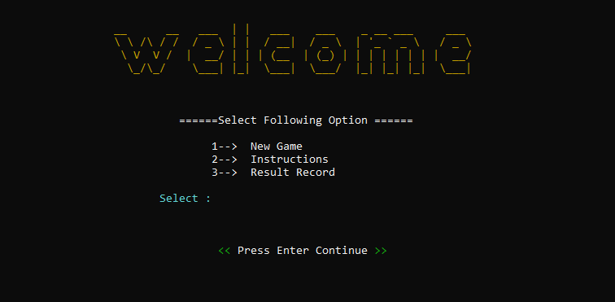
RESULTS AND OUTCOME
WELCOME SCREEN
OPTION MENU

Slide 9


RESULTS AND OUTCOME
1→ NEW GAME
USER INFORMATION

Slide 10



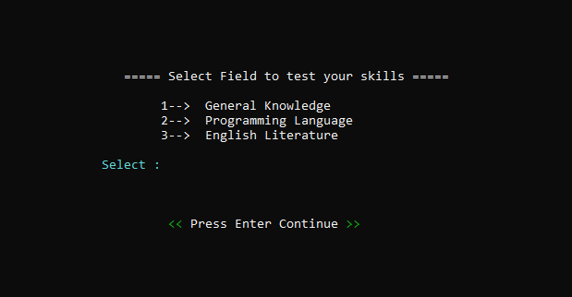
RESULTS AND OUTCOME
SUBJECT CHOICES

Slide 11


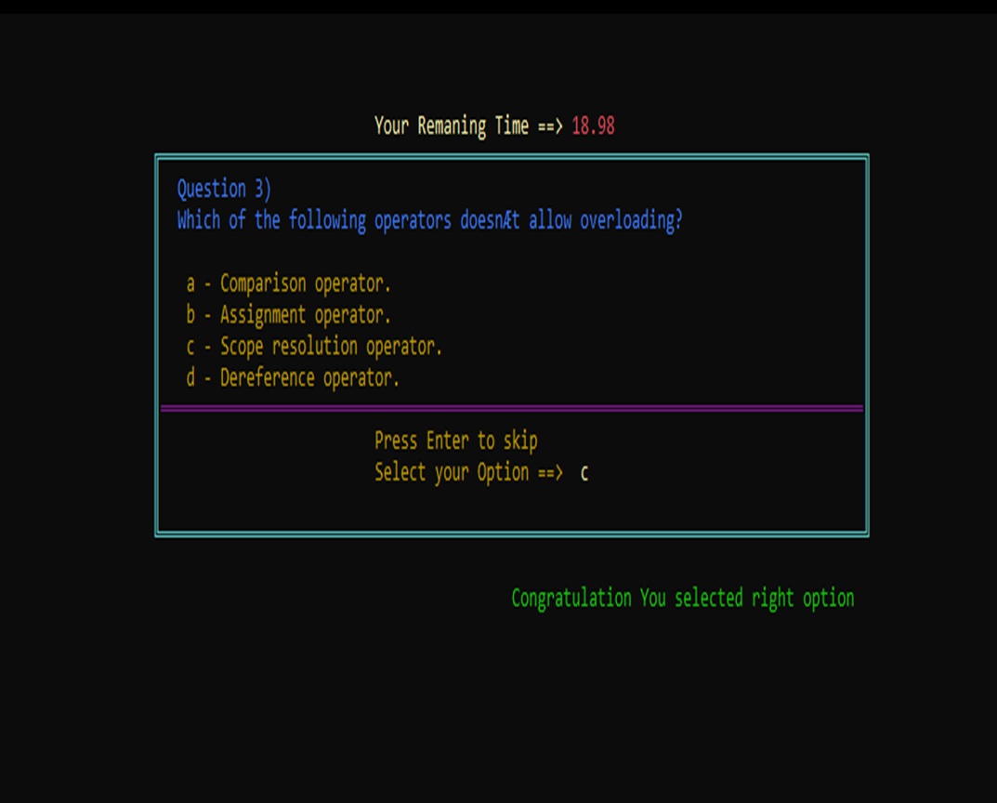
RESULTS AND OUTCOME
QUIZ BEGINS
CORRECT ANSWER

Slide 12

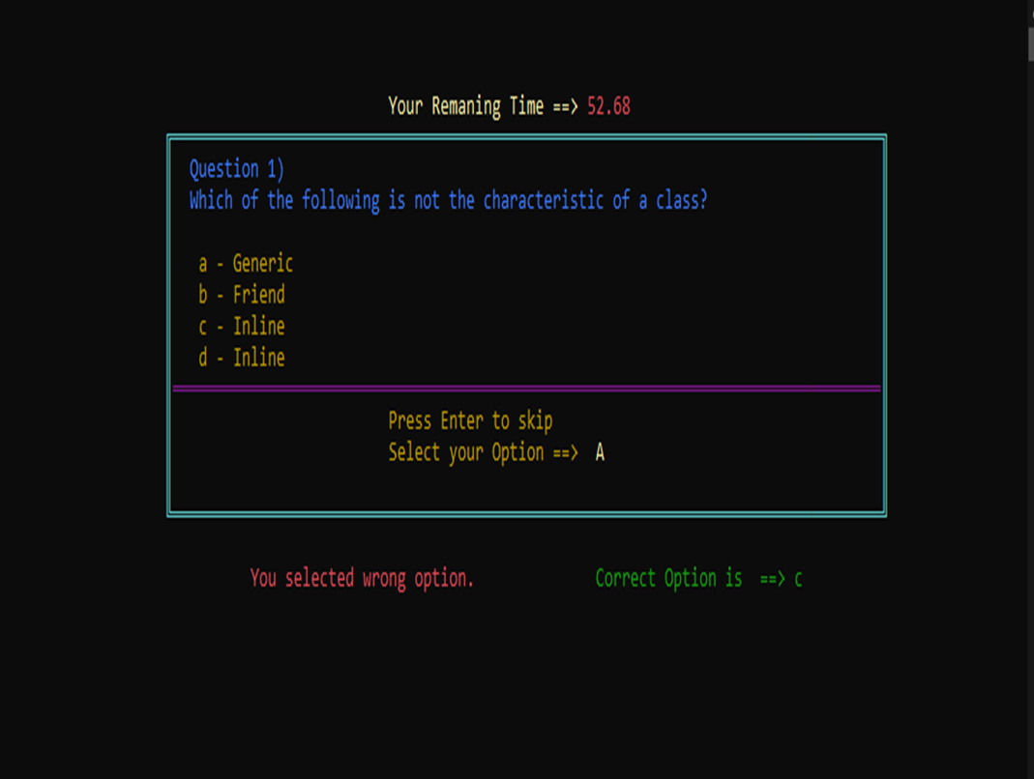
RESULTS AND OUTCOME
WRONG ANSWER

Slide 13
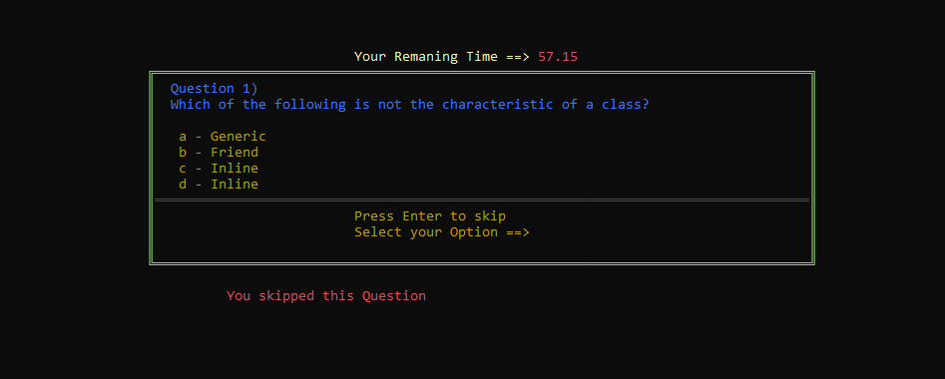
RESULTS AND OUTCOME
SKIP QUESTION

Slide 14
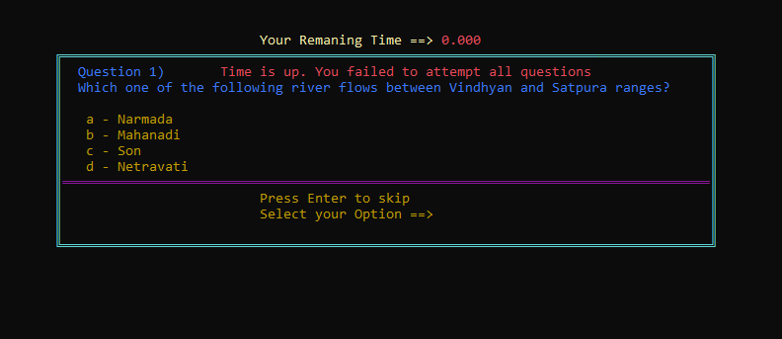
RESULTS AND OUTCOME
CASE OF TIME - UP

Slide 15
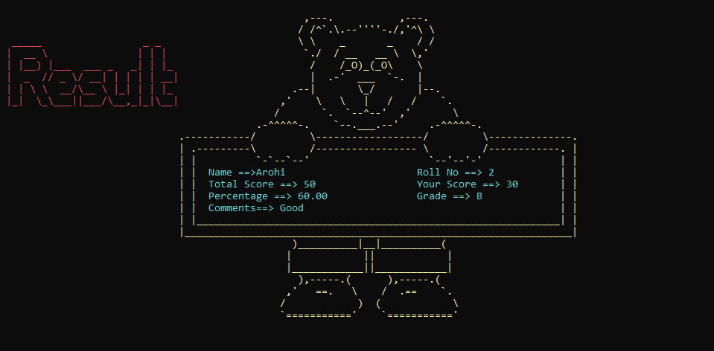
RESULTS AND OUTCOME
END OF QUIZ→ RESULTS

Slide 16

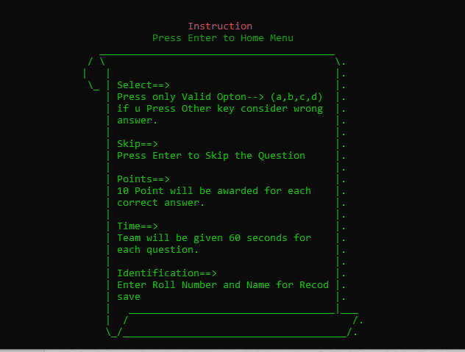
RESULTS AND OUTCOME
2→ INSTRUCTION MANUAL

Slide 17
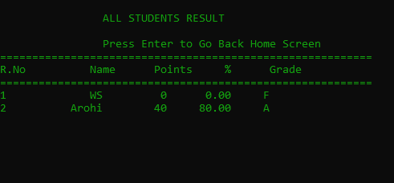
RESULTS AND OUTCOME
3→ RESULT RECORD

Slide 18
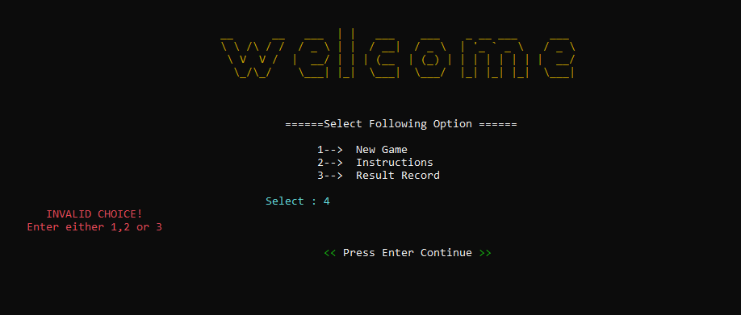
RESULTS AND OUTCOME
OPTION MENU
INVALID CHOICE

Slide 19
CONCLUSION
The Quiz Game designed is very interactive, user friendly and easy to play.
Recommendations are more and more games like these should be designed as it improves the knowledge and at the same time test your IQ level. Quiz games should be designed in a more interactive and friendly way so that more people can play, enjoy and at the same time improve, enhance and test their knowledge on various subjects.
The “Quiz game using C++” is to facilitate the user friendly environment to all users and reduce the manual effort. The proposed system is highly error free and mistake proof as no information has to be entered manually thus reducing the human prone errors. Database of the user is stored in a record file. In comparison to the previous system, the proposed system will be less time consuming and is more efficient.

Slide 20
FUTURE SCOPE
Scope to launch the quiz game on a website to make it more welcoming to users.
Scope to broaden the field of testing skills of the users by adding more question series to the game on various subjects.
Scope to add camera support for remotely taking this test in proctored mode.
Use of AI Plugins for further strengthening the security and robustness.
Scope to connect to cloud server for smooth data storage and easy automated result calculations.
Scope to implement in educational field to maintain student performance records.

Slide 21
REFERENCES
[1] “LET US C++” by Yashwant Kanetkar
[2] www.gobookee.net/objective-type-questions-C++-language
[3] www.gobookee.net objective-type-questions-and-answers-in-dbms
[4] www.gobookee.net objective-type-questions-and-answers-in-c
[5] “ The C++ Programming Language” by Bjarne Stroupstup
[6] “ Modern C++ Design” by Andrei Alexandrescu
[7] “Effective C++” by Scott Meyers

Slide 22
THANK YOU!

